Slide 1
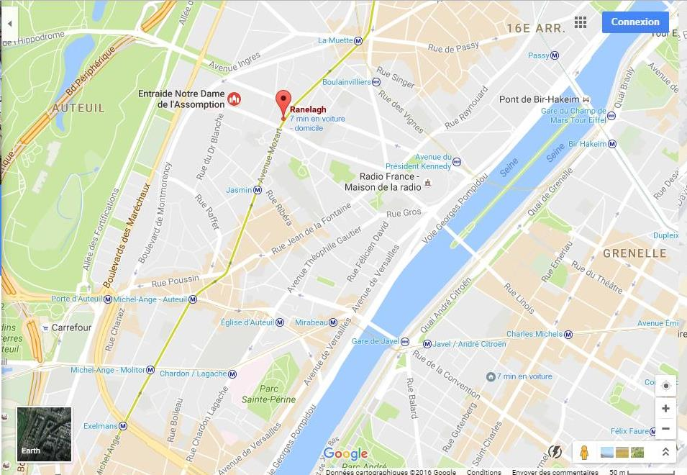
Metro L9: line pale green
- direct to st Philippe du Roule for Sunday
Metro La Muette : Family 2
Church of the Concert
on Sunday afternoon
Metro Ranelagh : Families 1 and 3
Métro Exelmans : Families 4, 5 and 6

Slide 2
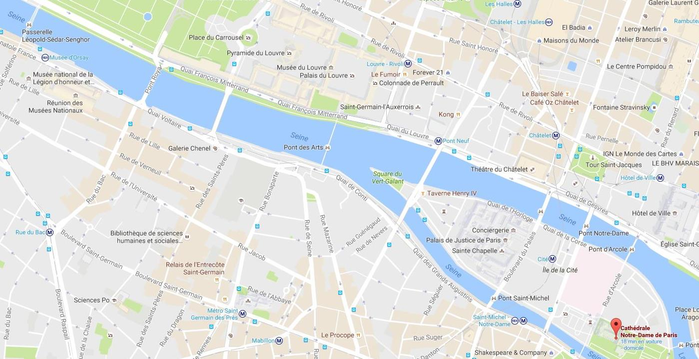
Paris 6e – visit of Monday 7th November
14h +/- free Visit of Le Louvre
Cz Cultural center
18 rue Bonaparte
2 meeting points : before 10h +
departure of the bus at 16h30
For Monday’s rehearsal
Pedestrian bridge
10h45 Meeting point Parvis de Notre Dame de Paris
Metro Ligne 12
Metro Ligne 10
Odeon // Metro Ligne 12/4

